Slide 1
Webinar Session
NHSE Tobacco Dependency Programme Patient Level Data Collection
Wednesday 11 October 2023
3-4.30pm

Slide 2
Webinar - 11 October 2023
NHSE Tobacco Dependency Programme Patient Level Data Collection
3pm – 3.45pm Part 1 – How to collect the right information
3.45pm – 4.30pm Part 2 – How to make the data work for you
Speakers
Paul Cilia-La-Corte - Senior Programme Manager (Prevention), NHS England
Tom Frost - Senior Analytical Manager, NHS England

Slide 3
Tobacco Patient Level Data Collection
BTS Webinar: 11th October
Presented by:
Tom Frost, Paul Cilia La Corte, Jack Hodgson,
NHS England Prevention Team
Notes:
Part one, collect the right information: look at what you need to be capturing and show you how
Part two, make the data work for you: how to make the data work to your advantage to ensure that you are getting the most out of the information you have
Proposed Format
Welcome & introduction from Chair
Part One presentation/demo -10-15 minutes
Questions - 20 minutes
Part Two presentation/demo - 10-15 minutes
Questions - 20 minutes
Chair to summarise and close

Slide 4
Part 1: Collect the Right Information:
Look at what you need to be capturing and showing you how

Slide 5

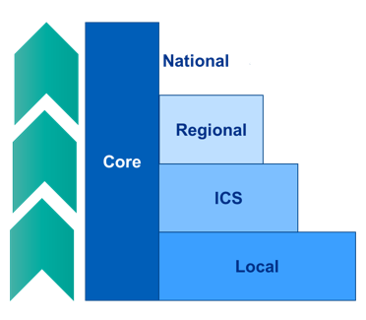
Data will demonstrate delivery, but more importantly effectiveness and drive improvements
The NHS is traditionally data-rich, but the challenge is to be able to access and use it intelligently.
There is a national data ask
You will want more granular local data
1. Delivery & throughput
2. Outcomes
3. Evaluation
Notes:
All people admitted to hospital who smoke will be offered NHS-funded tobacco treatment services.
Data is essential to support the roll out of these delivery programmes / patient level data >> HI / linkage
There are different asks depending on who is using the data – core data set to come national which will allow headline analysis – comparison between ICS /providers
Locally there will be more granular data that will help inform development of local pathways and identify local priorities
Is the intervention being rolled out and monitored – delivery of the LTP
Are services available to everyone? Volumes/populations
In addition to ensuring that people can access services, they have to be effective and deliver successful outcomes.
Are people quitting?
Who is quitting - is it the populations we expect?
Are there populations being engaged, but then not getting successful outcomes?
Action on tobacco dependence will underpin CORE20PLUS5 action plans and demonstrate progress
Evaluation is a key component of everything we do. The national programme will evaluate, but this should not preclude local learning to drive further improvements.
Short-term benefits for the NHS – sustainability.
Is there a local case to expand services – provider & ICS considerations
Comparison against peers?

Slide 6
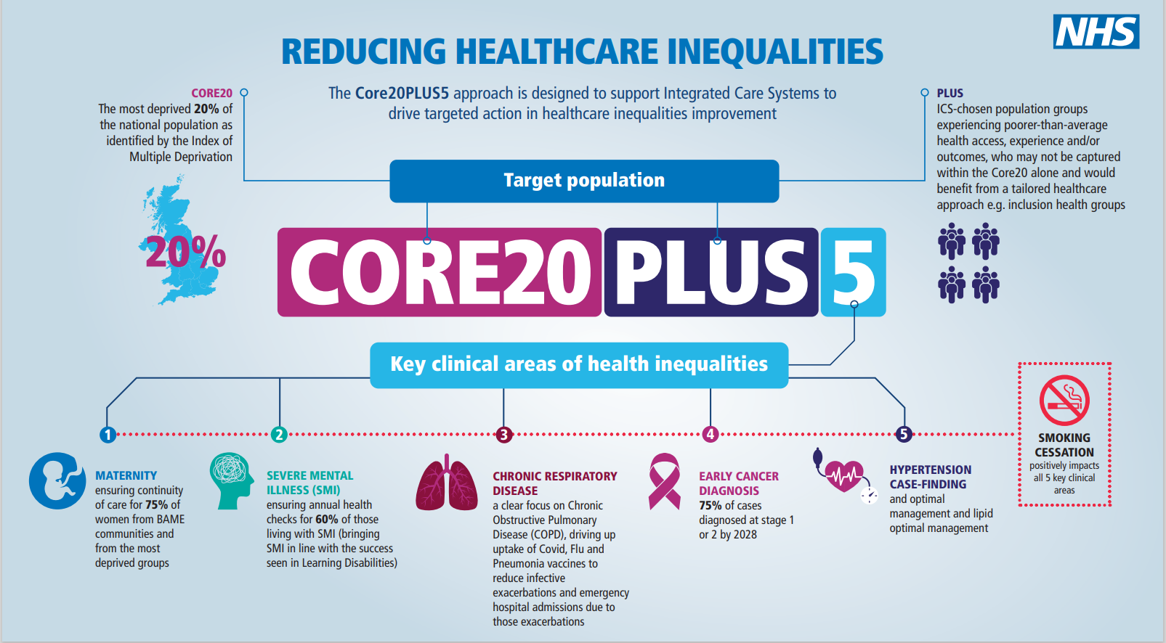
Notes:
We’ve developed metrics to help us see the impact we are having on the target (Core20Plus5) population.

Slide 7
Data Specification
Aggregate and Patient Level sections:
Aggregate – counts of patients with a recorded smoking status
Patient Level metrics – all (including those not referred who are smokers or e-cig users)
  Demographics (age, gender, ethnicity and location)
  Setting and why patients came to the hospital, e.g. an inpatient admission at an acute trust
  Details of this care episode (type, date, unique identifier)
  NHS Number – pseudonymised for use by NHSE
  Smoking status – at admission, booking or attendance (and delivery/36 weeks for maternity)
Patient Level metrics – those referred to the tobacco dependence service
  Whether patients were then seen by advisors and when
  The Tobacco Dependence Care Plan, i.e. the support they received or declined
  Pharmacotherapy used
  Whether they were referred on from the in-house service for further support elsewhere
  Outcome (28 days, 36 weeks, at delivery)

Slide 8
How to submit data
Scoping with clinical and BI teams
Building templates
Agreeing what is needed
Staff engagement & collection
Reporting
SDCS Portal:
  Download the submission template
  Enter data and upload within monthly submission window
Preparing data:
  Involve Business Intelligence
  Record on EPR/PAS where possible
  Tip: use intermediate spreadsheet
  Check validation (errors and warnings)
Getting help:
  Future NHS Workspace and Tobacco Data pages
  Use guidance & FAQs
  Ask for help – Futures or tobacco email (england.tobacco-prevention@nhs.net)
Notes:
Always check for new template versions
Walkthrough of SDCS portal process is on Futures
Don’t want an industry of Front line staff collecting extra information, this should all be part of the patient record so the best way to do it is to make it part of the electronic patient record.

Slide 9
Useful resources / links
Support materials include the data specification, guidance document, FAQs, SDCS walk-through video, recordings of previous webinars, Information Governance documentation and legal Directions.
Tobacco Dependence Data Collection: https://digital.nhs.uk/data-and-information/data-collections-and-data-sets/data-collections/tobacco-dependence
NHS England Prevention Programme: https://www.england.nhs.uk/ourwork/prevention/
Tobacco Dependence treatment services pages on Futures: https://future.nhs.uk/NHSpp/view?objectId=18882736
SDCS: https://datacollection.sdcs.digital.nhs.uk/
DQMI Dashboard (via the Tobacco dashboard or directly via the NHSE website):
https://digital.nhs.uk/data-and-information/data-tools-and-services/data-services/data-quality#updates
NHS Digital Data Collections team: data.collections@nhs.net
National programme: england.tobacco-prevention@nhs.net
Notes:
Data collections: For technical queries about submitting data via the SDCS portal, the reporting window and extensions
National programme team: For queries about tobacco dependence policy or about the patient-level data collection specification or guidance

Slide 10
Part 2: Make the Data work for You
How to make the data work to your advantage to ensure that you are getting the most out of the information you have

Slide 11
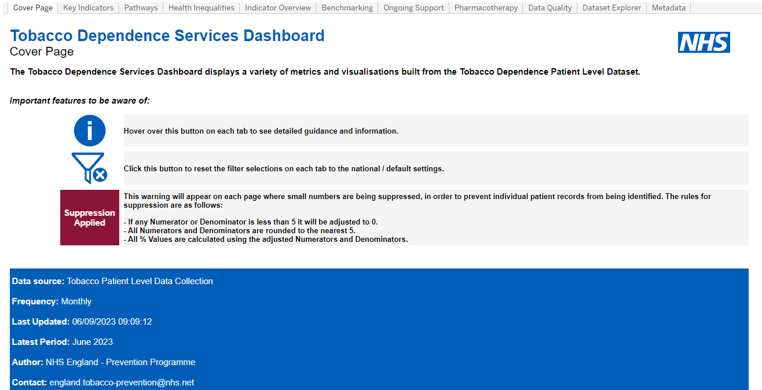
Tableau Dashboard – functionality
Tobacco Dependence Programme Patient Level Dashboard
  KPIs
  Benchmarking
  Pathways visualisation
  Time series analysis
  Health inequalities
  Deprivation focus
  Ongoing support
  Pharmacotherapy
  Data quality
  Data explorer
  Metadata
Notes:
Hosted on NHS Futures

Slide 12
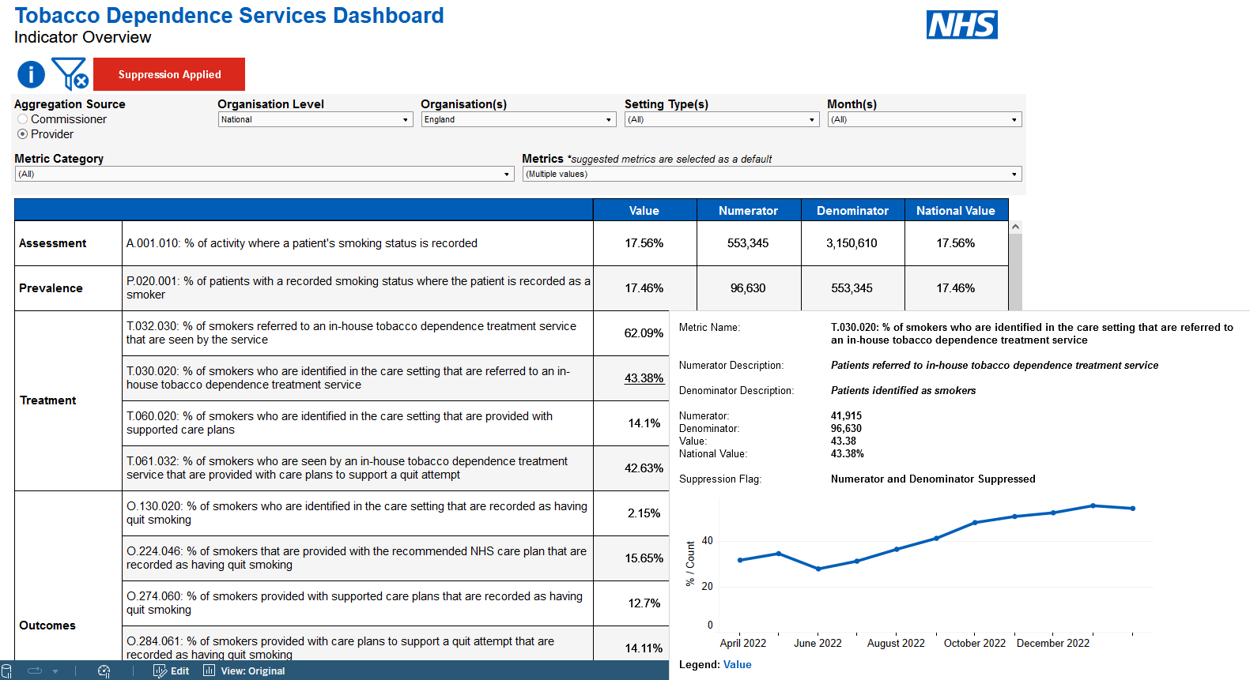
Tableau Dashboards – functionality
Notes:
The Outputs from the RAP pipeline are published monthly in Tableau dashboards with extensive filters and flexibility.
The Dashboards are intended to be used at all levels of the organisation, by staff at Trusts, ICBs, Regions and NHSE.
Most users are not analysts. The format is as user friendly as possible.
Tooltips, information buttons and guidance are used heavily throughout.
A video walkthrough is also published alongside.

Slide 13
Tableau Dashboards – Demonstration video
Notes:
Run time: 12:34

Slide 14
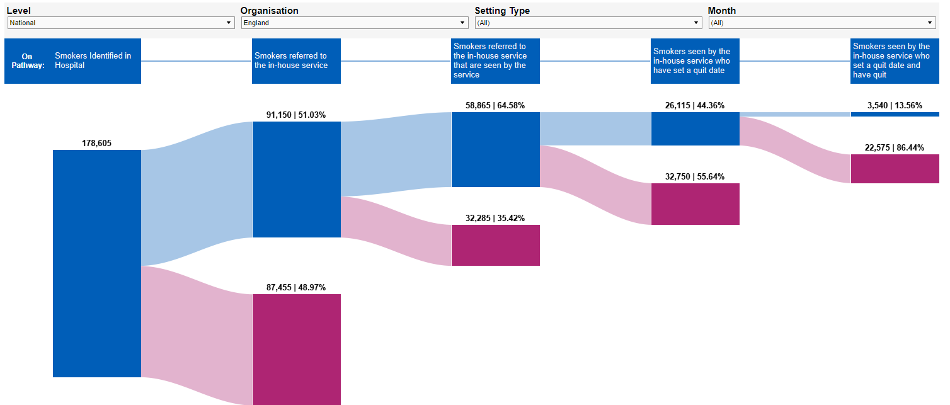
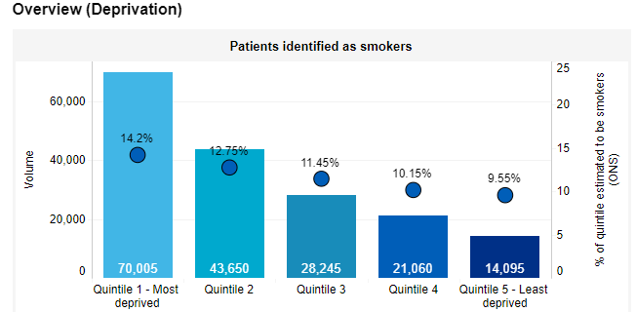
Tableau Dashboards – Access
Users need to register with:
FutureNHS
The Tobacco section on the Prevention Programme workspace
NHSE Applications
We are currently managing access
in conjunction with regions to ensure that
the userbase is onboarded appropriately
and understands the purpose of the dashboard and any data quality issues.
Dashboard:
https://future.nhs.uk/NHSpp/view?objectID=35731056
Notes:
Weekly extract of newly registered users
Don’t need to email and ask for DB access – just register as above

Slide 15
Next steps and other resources
Tobacco Dependence Dashboard:
Return on Investment section
Further health inequalities analyses
Evaluation and data linkage
ASH tools: https://ash.org.uk/resources/smokefree-nhs & https://ash.org.uk/resources/local-toolkit/datacostcalculators
  ASH Ready Reckoners: financial cost of smoking in ICBs, local authorities, combined authorities, regions and England. Includes social care, fire; healthcare; lost productivity; and spend on tobacco.
  Tobacco Dependence Treatment Service Return on Investment Calculator: estimates the impact of fully implementing Tobacco Dependency Treatment Services (TDTS) on indicators including hospital readmissions, A&E presentations, financial savings and lives saved.
  ASH Economic and health inequalities dashboard
  Budget calculations template: https://ash.org.uk/resources/local-toolkit/developing-a-system-wide-tobacco-control-programme

Slide 16
End slide

