Slide 1

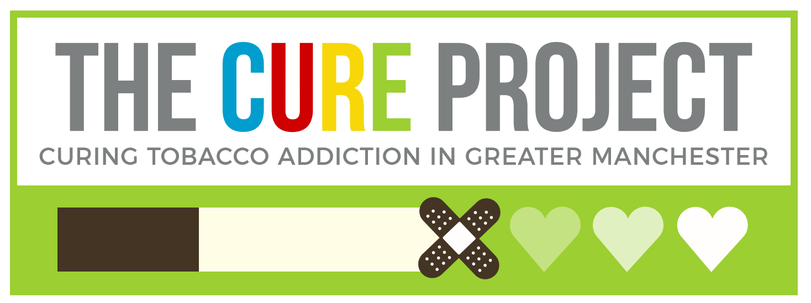
NHSE&I LTP Tobacco Addiction Treatment Programme:
EIS Workshop 1:
Clinical Leadership & CURE Specialist Nurse Team
Freya Howle
CURE Programme Lead, Greater Manchester Cancer
NHSE&I Programme Implementation Adviser – Tobacco Dependence

Slide 2
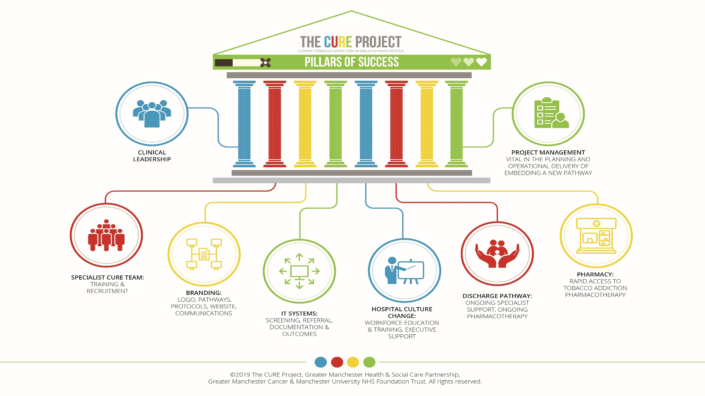
Notes:
Freya

Slide 3
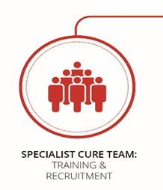
What will we cover today
Importance of a clinical and nurse lead?
Key responsibilities
  Promotion of service and message – treatable addiction not lifestyle choice
  Peer support and challenge
  Opening doors
Training – being the expert on behalf of your Trust!
The Specialist CURE Team
Why band 6 qualified nurses? A presentation given by the lead CURE nurse at our pilot site Wythenshawe Hospital
Q&A – open honest discussion
Each EIS will share…
  Do you have a clinical and nurse lead?
  How is engagement with them?
  What do have the done to support engagement?

Slide 4

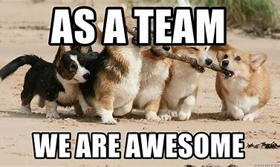
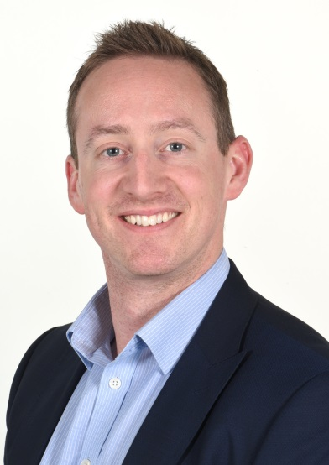

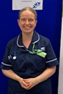
The importance of clinical & nurse leadership
Project Manager
Fountain of knowledge of current service
Existing lead of service – known to nurses and wards
Detailed first hand experience of day to day challenges
Respiratory Consultant
Respected by peers
Involved in local & ICS level innovation
Clinical & medical knowledge
Clinical Lead
Nurse Lead
Promotes message of clinical importance
Medical responsibility to treat this disease

Slide 5



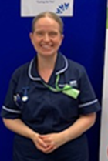
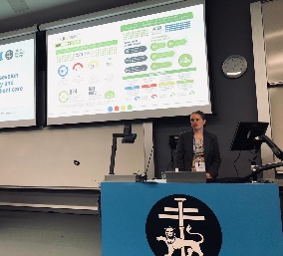

..Would answer any clinical query & ensure clinical information provided in communications was accurate..
..Engaged executive level support..
..Challenged peers thinking around smoking..
..Finger on pulse of publications & evidence to support case for change..
..Present on behalf of team at prominent regional and national network events..
KEY RESPONSIBILITIES
…knowledge of ‘what there was before’ and how smoking cessation services were delivered and what needed to be updated…
…link between service and ward nurses…
…engage staff with relatable passion for treating patients…
….visibility on wards through training & ‘walk arounds’…

Slide 6
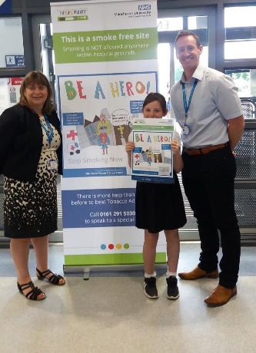
Clinical leadership – what can make a difference
Training the workforce:
Support the culture change/change in attitude
Access every level of medical staff – FY1, FY2, speciality, induction day, Grand Rounds
Having a ‘homegrown’ expert empowers wider staff
What can you do as a project manager to get the best out of the role…
Get a schedule from the Education Team - when the standard training sessions are for each level of doctor/nurse from students to consultants
Produce literature for wider training forums or education opportunities eg grand rounds
Be open and honest with your lead as to what the expectation is – plan involvement in meetings
Clinical Lead
Consultant backing for acute transformation will open more doors

Slide 7
The Specialist CURE Team:
What do they do (apart from saving lives by treating tobacco addiction)?

Slide 8

Training
Training and competency package for all new team colleagues
Training by Clinical Lead to inspire everyone!
CURE tobacco addiction treatment manual
Training by Nurse Lead on background to S.C. / service pre CURE / Triggers & cravings / Behavioural support / Difficult questions & scenarios / Tobacco addiction medications / NRT PGD & competency sign off
Time shadowing other team colleagues
CURE level 1 & 2 e-learning
NCSCT online training especially Level 1

Slide 9
Implement
Include all crucial & interested parties – can avoid problems later: ie GPs / Pharmacists re supply of medication
Develop documents / processes
Build on existing S.C service
Efficient, confident and skilled project management
Service structure: band 7 & band 6’s
Recruitment & training of new colleagues
Patience with obstacles: EPR / No Inhalator initially / slow recruitment
Promotion of project everywhere!
E-learning for Trust staff with examples: ‘Everyone's responsibility’

Slide 10
Delivering
Influence EPR/recording system updates to allow service data collection
Striving for targets
Re evaluating what works: Looking at staff ratios / grading
Try different things to see what adds benefit: VBA Triage
Communication – can be difficult when things are stressful, evolving
Sharing results / Progress / Difficulties / Successes
Deliver / Review / Develop - Repeat
Maintain passion for project despite ups and downs

Slide 11

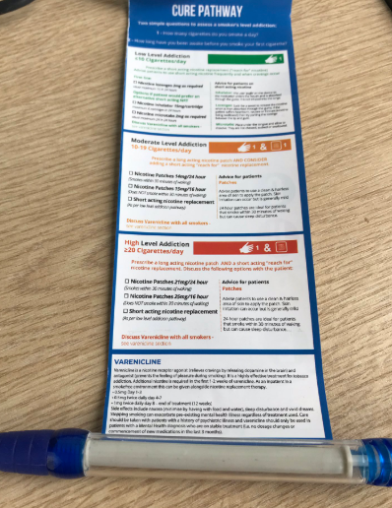
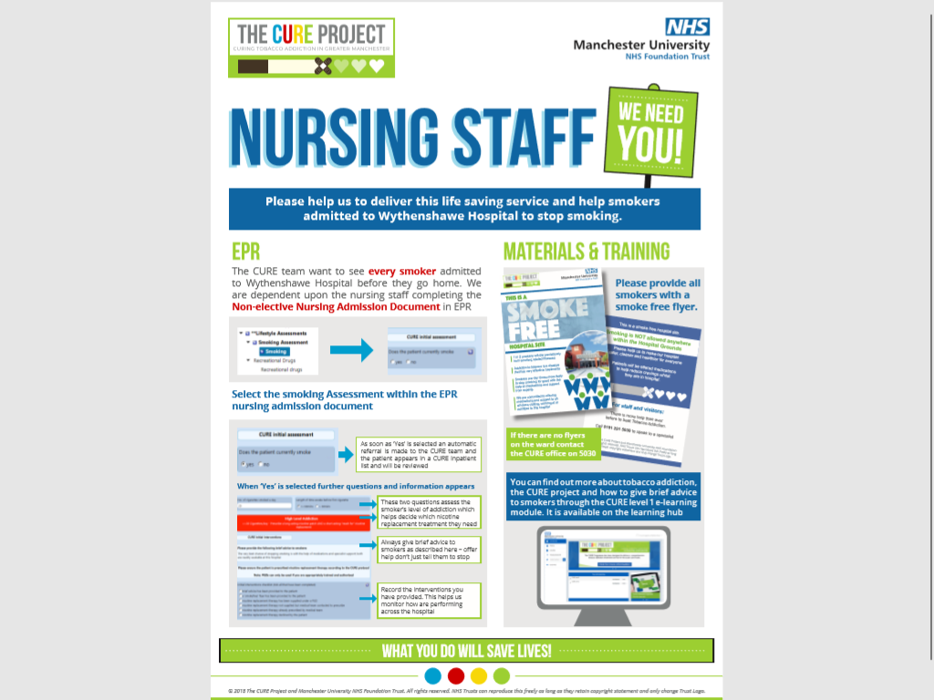
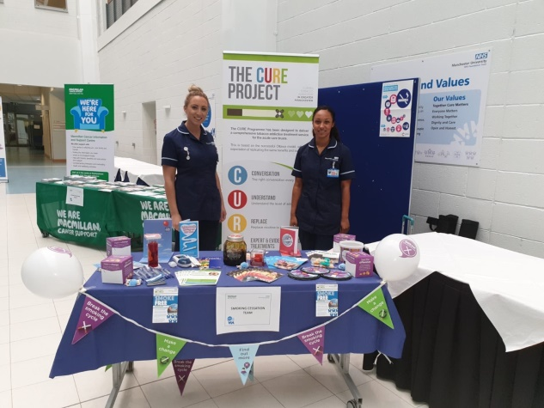
Go and introduce yourself…
Visit the wards – start with those where there will be a high concentration of referrals
Take goodies!
  Everyone love pens
Update the intranet with team details – ensure it is easy for people to contact you
Recruit champions to help the cause – offer bespoke training sessions for interested staff
Be the experts
Notes:
Freya

Slide 12
The CURE team: why qualified Nurses?
A presentation given by the lead of the CURE Specialist Team at Wythenshawe based on experience of implementing the service

Slide 13
Why qualified Nurses?
Especially helpful in secondary care environment
Fits well in a clinical setting
Helps buy in from and across the organisation
Our patients have complex histories and multiple medical conditions – nursing background is crucial in dealing with and understanding this
Helps in MDT acceptance of the service
Helps access to Trust wards and departments
Ownership of the service by the organisation has been a crucial part of buy in and culture change

Slide 14
Why Band 6 Specialist Nurses?
The demands of the job and complex patients
Nurse led clinics require a good level of previous nursing knowledge and skill – we currently ask for a minimum of 3 years experience at Band 5
The demands and responsibilities of the role are a learning curve for all new colleagues joining the service
It’s a specialist role and needs to be acknowledged as such
Is appealing to colleagues to apply (recruitment is tricky!)
Ability to take on leadership roles within the team (e.g. lung health check lead) and build teams beneath them (e.g. band 4/5) in the future

Slide 15
A few numbers…
All referrals to service
June 2019 431
July 2019 659
August 2019 713
Over 50 inpatients seen every week
CURE Project Pilot outcomes: 6 months & 2500 smokers
824 medication additions or change by CURE team
61% of patients had specialist CURE team assessment
42% Quit Rate at 4 weeks

Slide 16
Staffing
Pre CURE-pilot
Post CURE-pilot
3x Band 6 Nurses
Full-time
Opt-in model for inpatients & outpatients
1x Band 7 lead – Full-time
8x Band 6 – Full-time
2x Band 6 – to be recruited
Admin
2x Band 3 – Full-time
1x Band 3 – Part-time
Opt-out model for inpatients (CURE), outpatient referrals, opt-out model for lung health check service

Slide 17

Over to you…
Let’s discuss…
Do you have a clinical and nurse lead?
Describe their role in the hospital currently?
How do you work together?
What are their roles and responsibilities?

