Slide 1
NHS LTP Treating Tobacco Dependence Programme
Governance & Leadership within Trusts
Published 04-11-21

Slide 2
“Failure to identify & treat smoking is no less negligent than failure to identify & treat cancer”
RCP Hiding in Plain Sight, 2018
Smoking is still the largest cause of preventable ill health and premature death in England.
Treating tobacco dependency systematically will;
Reduce health inequalities, smoking accounts for more than half the difference between life expectancy between richest & poorest.
Reduce demand on the NHS short term via readmissions and long term from preventing ill health,
Make a significant contribution to the levelling up agenda, both by reducing harm and increasing the amount of money people have to spend & save.

Slide 3
NHS Long Term Plan Objectives
By 2023/24;
All people admitted to hospital who smoke will be offered inhouse NHS-funded tobacco treatment services [including Acute and MH inpatients].
The model will be adapted for expectant mothers, and their partners as part of Maternity Services
A new offer for higher risk outpatients will be available as part of specialist mental health and disability services
The recommended model is a comprehensive tobacco addiction treatment service providing all smokers with evidence-based interventions to stop smoking on admission to hospital or at booking with a midwife. This includes timely access to medications and specialist support, provided as an ‘opt-out’ model with all healthcare professionals taking responsibility for their part in the service

Slide 4
TRUST LEVEL: LEADERSHIP
For successful delivery of routine, systematic treatment of tobacco dependency within both inpatient services and maternity services, it is essential there is support at the highest level within trusts and that it is embedded within a Trust wide strategy and Smokefree Policy.
It is recommended that each Trust nominates an Executive Sponsor and Clinical Lead. These roles will provide insight into how funding can be most effectively channelled within the Trust to deliver a comprehensive tobacco dependency service as well as advocate locally for the provision of additional resource and support to maximise the benefit..
Executive Sponsor
Understanding and endorsement of all aspects of treating tobacco dependency agenda should be provided at Executive level.
The role of the Executive Sponsor is;
To champion the Tobacco workstream at the Executive board, including advocating and securing support from different departments.
To provide an escalation route and high-level dispute / problem resolution to support the unblocking of barriers during the implementation.
Serve as Senior Responsible Officer and contact for ICS in relation to programme assurance.
Clinical Lead
The role of the Clinical lead within a Trust is to;
Drive forward the establishment of a systematic, opt-out onsite tobacco treatment service, providing oversight to the scoping and development of delivery plan.
Champion tobacco dependency and treatment at Trust level and will drive engagement with clinician across different departments within the Trust.
Provide clinical support to project managers and operational Tobacco Treatment Services team
Oversee any key performance indicators.
Work with the Executive Sponsor to highlight and resolve anticipated challenges.
Notes:
Objectives
The group will link to the overarching objectives of the relevant Trust Board/Hospital Prevention Group and provide assurance to the Group that the following objectives are addressed:
To provide strong leadership and management support to support the implementation of the Trusts Smoke free policy and the NHS Long Term Plan Treating Tobacco Dependency commitments
Provide a forum for raising and addressing issues arising from smoke free sites and harm reduction
Ensure compliance with NICE Guidance PH48 and other national guidance
Establish onsite NHS treating tobacco service in line with the Smoke Free Regional Taskforce delivery models
Ensure training and support is available to enable staff to deliver smoking cessation interventions
Ensure the Trust complies with relevant legislation
Monitor changes in smoking prevalence amongst patients and staff
Monitor and manage smoking-related incidents
Identify and disseminate lessons learned and good practice internally and externally
Assure the Hospital Prevention Group/Trust Board that appropriate systems and processes to achieve a ‘Smoke Free Hospital Trust’ are in place and continue to monitor these processes moving forward.

Slide 5
TRUST LEVEL: TREATING TOBACCO DEPENDENCY STEERING GROUP
Purpose:
To provide operational insight and support the development and delivery of an onsite tobacco dependency treatment service as set out in the NHS Long Term Plan. In addition, the role of the Steering group is to ensure a systematic Trust wide approach to implementation of NICE guidance, including robust medication pathways & protocols, staff training plan, communications plan and support for staff to improve their own health and wellbeing.
Suggested Objectives:
The group will link to the overarching objectives of the relevant Trust Board and provide assurance that the following objectives are addressed:
To provide strong leadership & management support to support the implementation of the Trusts Smokefree policy and the NHS Long Term Plan Treating Tobacco Dependency commitments,
To establish onsite NHS treating tobacco service following the NHSEI recommended models & monitor progress against key milestones,
To provide a forum for task & finish groups to report into,
To ensure training plans are in place & support is available to enable staff to deliver tobacco treatment interventions,
To ensure compliance with NICE Guidance NG209 and other national guidance, as well as all relevant legislation,
To receive monthly updates from the Trust on NHSEI Tobacco Treatment Service reporting metrics & monitor implementation, engagement and quit outcomes amongst patients and staff, as well as changes in smoking prevalence amongst patients
To monitor and manage smoking-related incidents, and provide a forum for raising and addressing issues arising from smoke free sites and harm reduction
Identify and disseminate lessons learned and good practice internally and externally
Assure the Trust Board that appropriate systems and processes to achieve a ‘Smoke Free Hospital Trust’ are in place and continue to monitor these processes moving forward.
Notes:
Objectives
The group will link to the overarching objectives of the relevant Trust Board/Hospital Prevention Group and provide assurance to the Group that the following objectives are addressed:
To provide strong leadership and management support to support the implementation of the Trusts Smoke free policy and the NHS Long Term Plan Treating Tobacco Dependency commitments
Provide a forum for raising and addressing issues arising from smoke free sites and harm reduction
Ensure compliance with NICE Guidance PH48 and other national guidance
Establish onsite NHS treating tobacco service in line with the Smoke Free Regional Taskforce delivery models
Ensure training and support is available to enable staff to deliver smoking cessation interventions
Ensure the Trust complies with relevant legislation
Monitor changes in smoking prevalence amongst patients and staff
Monitor and manage smoking-related incidents
Identify and disseminate lessons learned and good practice internally and externally
Assure the Hospital Prevention Group/Trust Board that appropriate systems and processes to achieve a ‘Smoke Free Hospital Trust’ are in place and continue to monitor these processes moving forward.

Slide 6
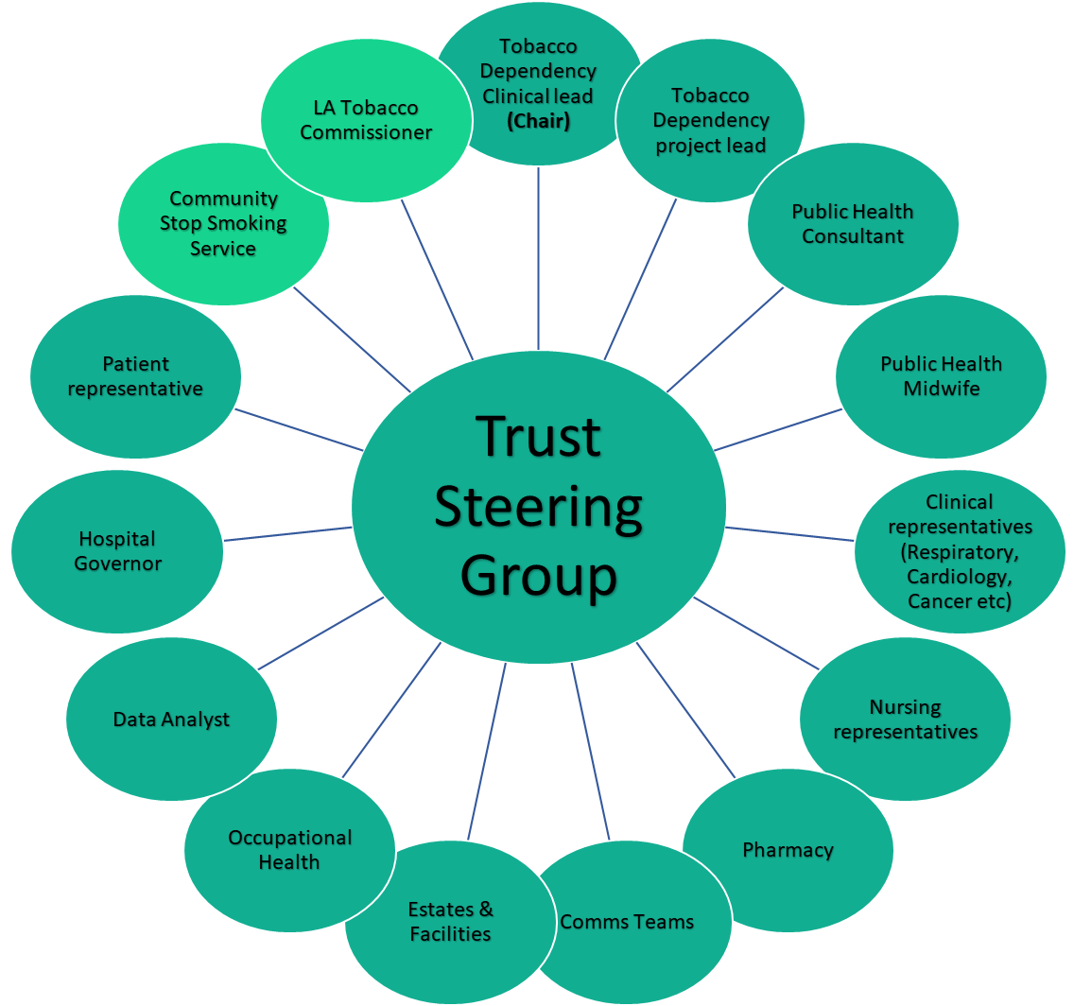
TREATING TOBACCO DEPENDENCY STEERING GROUP: SUGGESTED MEMBERSHIP
Not exhaustive – membership may vary by individual Trust
Trust Tobacco Dependency Steering group should be chaired by the Clinical lead & feed into existing Trust governance structures to provide escalation to Executive board
Template Terms of Reference embedded below
Clinical representatives (Respiratory, Cardiology, Cancer, Obstetrics etc)
Notes:
Objectives
The group will link to the overarching objectives of the relevant Trust Board/Hospital Prevention Group and provide assurance to the Group that the following objectives are addressed:
To provide strong leadership and management support to support the implementation of the Trusts Smoke free policy and the NHS Long Term Plan Treating Tobacco Dependency commitments
Provide a forum for raising and addressing issues arising from smoke free sites and harm reduction
Ensure compliance with NICE Guidance PH48 and other national guidance
Establish onsite NHS treating tobacco service in line with the Smoke Free Regional Taskforce delivery models
Ensure training and support is available to enable staff to deliver smoking cessation interventions
Ensure the Trust complies with relevant legislation
Monitor changes in smoking prevalence amongst patients and staff
Monitor and manage smoking-related incidents
Identify and disseminate lessons learned and good practice internally and externally
Assure the Hospital Prevention Group/Trust Board that appropriate systems and processes to achieve a ‘Smoke Free Hospital Trust’ are in place and continue to monitor these processes moving forward.

Slide 7
FutureNHS Collaboration Platform
NHS Prevention Programme FutureNHS workspace provides a central platform for resources that support and relate to the NHS Long Term Plan commitments for Prevention. It provides a secure space where colleagues throughout the system can share materials, information, plans and ideas
https://future.nhs.uk/NHSpp/grouphome

Slide 8
OHID Tobacco Control Managers
North East & Yorkshire Joanna.Feeney@dhsc.gov.uk
North West Rachel.Swindells@dhsc.gov.uk
Midlands James.Gillies@dhsc.gov.uk
East of England Claire.Parker@dhsc.gov.uk
London Alanna.Molloy@dhsc.gov.uk
South East Naseem.Mushtaq@dhsc.gov.uk
South West Natalie.Sims@dhsc.gov.uk

