Slide 1

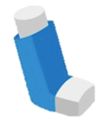


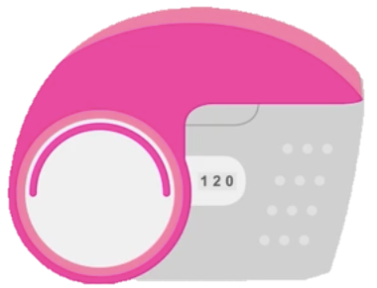
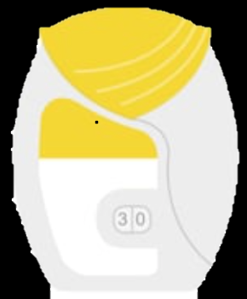


Promoting respiratory health with ...planet friendly inhalers
Climate change worsens respiratory health
NHS is responsible for ~5% of UK’s carbon footprint¹
Metered-dose inhalers (MDIs) are ~3% of NHS carbon footprint¹
Dry powder inhalers (DPIs) and soft mist inhalers (SMIs)
  often a suitable alternative
  carbon footprint 20-30 times less than MDIs²
NICE and the British Thoracic Society support low
carbon inhaler prescribing ^{4,5}
Equivalent CO₂ emissions in car miles^{3:}
MDIs
175 miles: London to Sheffield
DPIs
4 miles: Denmark Hill to Victoria
Carbon level | Reliever | Low dose ICS | Low ICS & LABA | Moderate ICS & LABA | High ICS & LABA | ICS & LABA & LAMA
Low | Salbutamol Easyhaler Ventolin Accuhaler | Beclometasone Easyhaler | Fostair NEXThaler
Mod. | Salbutamol MDI | Clenil Modulite MDI | Fostair MDI | Fostair MDI | Fostair MDI | Trimbow MDI
High | Ventolin Evohaler |  | Flutiform or Symbicort MDI | Flutiform or Symbicort MDI | Flutiform MDI
Fostair NEXThaler
Relvar Ellipta
Fostair NEXThaler
Trelegy Ellipta
Relvar Ellipta
Fostair NEXThaler
+ any LAMA
NB. All LAMA inhalers are DPI or SMI and therefore low carbon inhalers.
When to switch:
spacer not required
patient happy to change
able to achieve required technique
When not to switch:
low inspiratory flow rate
patient preference
risk of destabilising disease control
Remember: The most sustainable inhaler is the inhaler that best supports the patient and minimises hospital admissions
Other carbon-saving strategies!
Education to reduce need for reliever
Choose reusable inhalers or replace cartridges where possible
Prescribe combination inhalers where possible
Use higher dose preparation to reduce number of puffs
Optimise inhaler technique
[1] https://www.england.nhs.uk/2020/01/greener-nhs-campaign-to-tackle-climate-health-emergency/; [2] Janson C et al. Carbon footprint impact of the choice of inhalers for asthma and COPD. Thorax 2020;75: 82-84; [3] Green Inhaler. The Problem with Inhalers [online]. Available at: https://greeninhaler.org/the-problem-with-inhalers/; [4] National Institute for Health and Care Excellence. Patient decision aid: inhalers for asthma. NICE 2020; [5] British Thoracic Society. Position Statement: The environment and lung health. March 2020.

