Slide 1



British Thoracic Society
Sustainability Toolkit
Example Teaching Slides
June 2026
https://brit-thoracic.uk/SustainabilityToolkit
Notes:
Speaker notes: these slides are designed to make it easier for you to incorporate sustainable healthcare into your everyday teaching and practice. Add a slide or 2 to your existing talks to make sustainable healthcare business as usual.

Slide 2

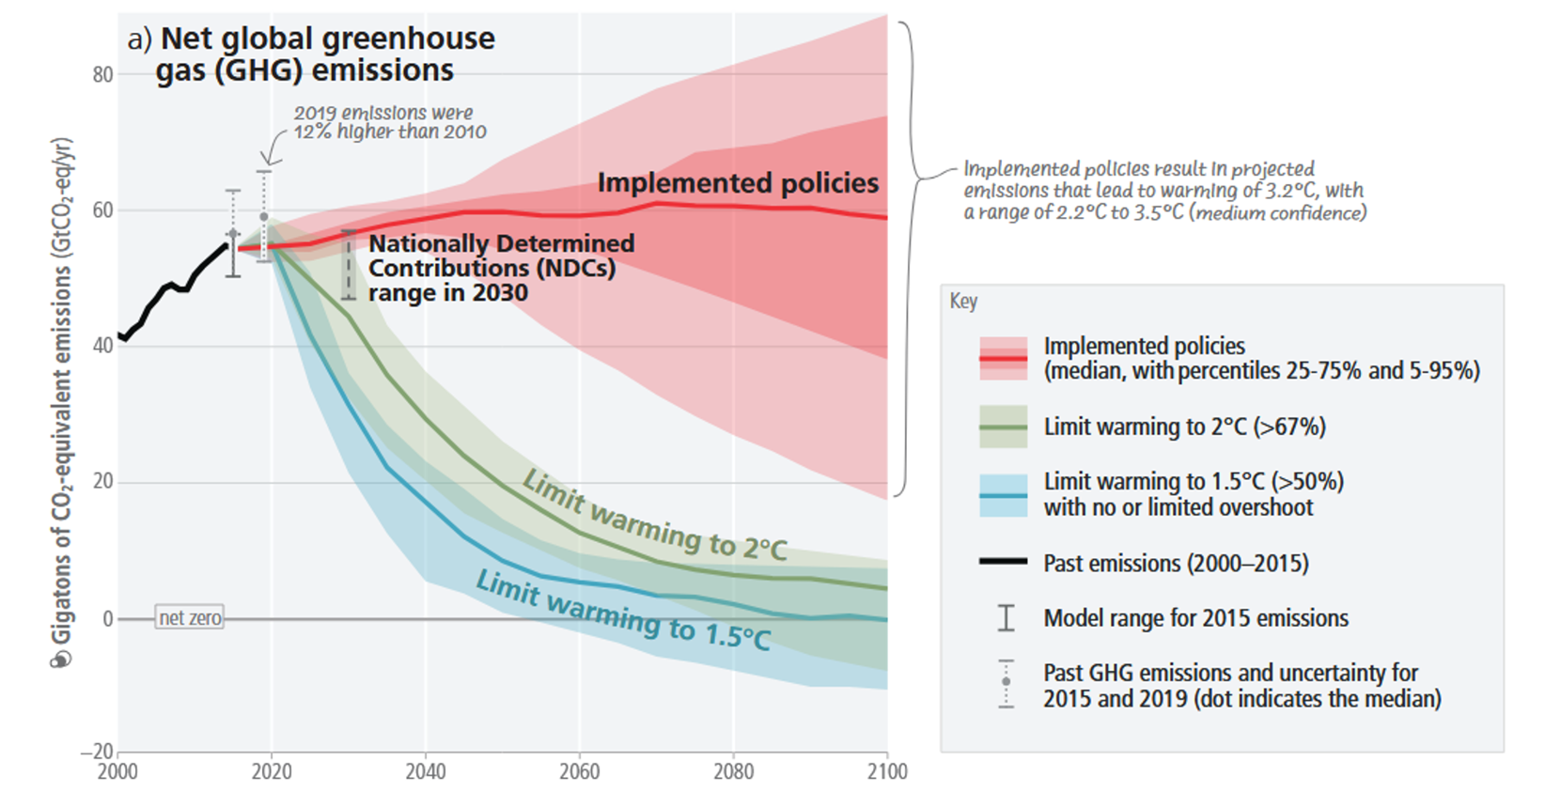
Climate change: current trajectory
https://brit-thoracic.uk/SustainabilityToolkit
Image credit: IPCC AR6 Synthesis Report Climate Change 2023 ipcc.ch/report/ar6/syr/
Notes:
Speaker notes: our actions so far have not been fast enough. On our current trajectory, if we implement all the policies that have been agreed (but not yet enacted) then we are heading for warming of 2.2-3.2C of warming. This will have major health, as well as economic and political consequences.

Slide 3
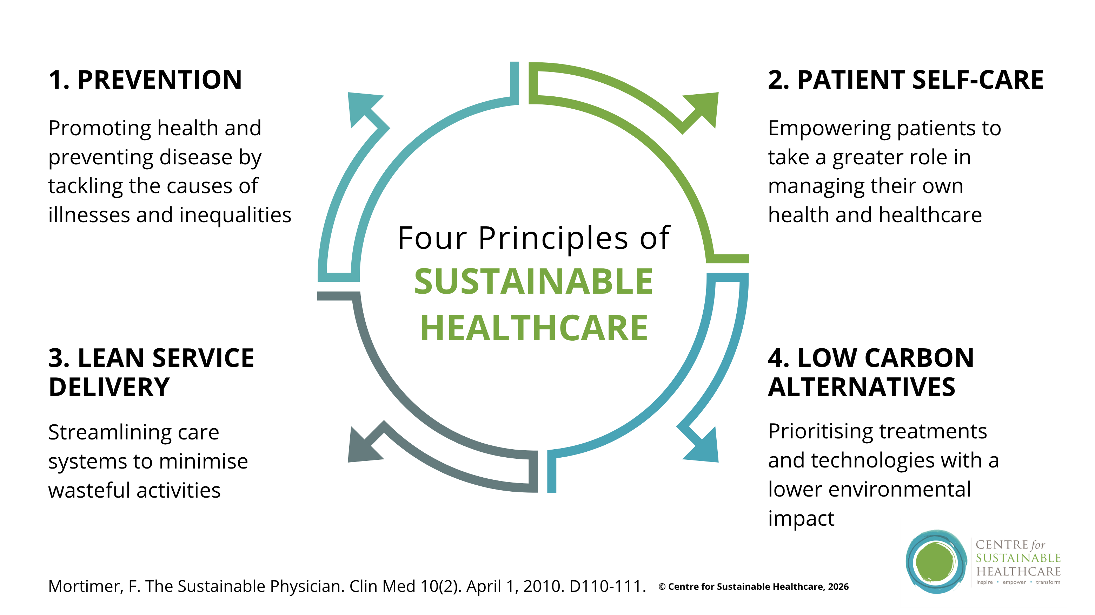
Principles of sustainable healthcare
https://brit-thoracic.uk/SustainabilityToolkit
Image used with permission from Centre for Sustainable Healthcare
Notes:
Speaker notes: The principles of sustainable healthcare can be applied to any medical/surgical speciality, pathway or intervention. This is a framework that everyone in healthcare needs to apply in every QI project, service review, evaluation or business case.

Slide 4
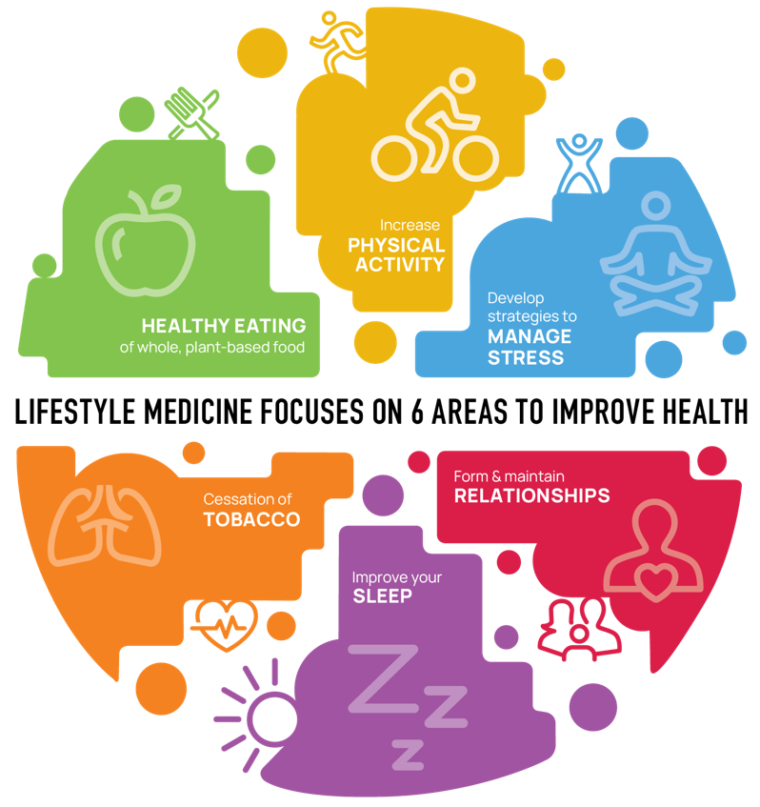
Prevention
How can you support your patients to adopt healthy habits?
Improve your knowledge
Develop skills in motivational interviewing
Signpost to further support
What is Lifestyle Medicine? - Find Out From British Society of Lifestyle Medicine
brit-thoracic.uk/SustainabilityToolkit
Image credit: American College of Lifestyle Medicine
Notes:
Speaker notes: Prevention is a key part of sustainable healthcare. The lowest carbon treatment is the one the patient doesn’t need! The 6 pillars of lifestyle medicine provide a useful framework to talk about the most evidence-based interventions for both primary prevention and secondary prevention. There is a wealth of evidence on these areas which is often absent from healthcare education, but organisations such as the British Society of Lifestyle Medicine are bridging this gap.

Slide 5
Healthcare can tip the balance on climate change
The world needs 45% fall in emissions by 2030 to secure a liveable future (<1.5C)
Healthcare:
  5% global GHG emissions
  12% GDP
  Influences up to 70% of supply chains
  Employs >150million people worldwide, 1.4million in the UK
If we act, together, the world changes
https://brit-thoracic.uk/SustainabilityToolkit
Notes:
Speakers notes: healthcare is a huge industry which means that it touches many people, businesses and supply chains. It is important to remember this as sometimes our interventions such as swapping from one syringe to another with a lower carbon footprint can seem small. But the real power of healthcare is that these small interventions add up because we are large industry, and our demand for care that has a lower environmental impact drives industries more widely to improve their products and practices. We also have the potential to influence many people by educating our staff and empowering our patients. This has the potential to tip the balance on the societal shifts we need to live in a way that is in harmony with our environment.

Slide 6

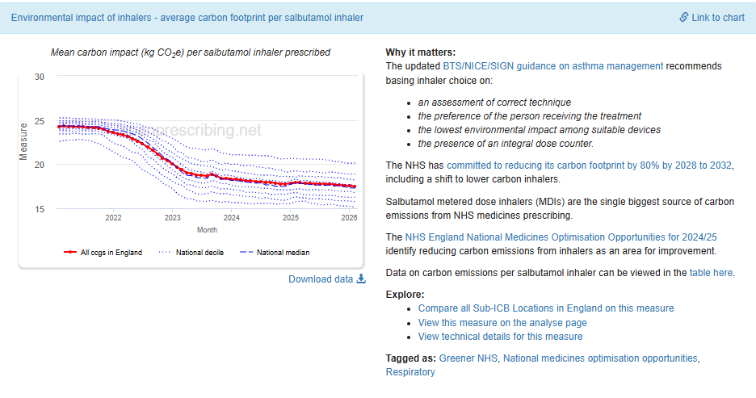
Inhalers: incredible progress
https://brit-thoracic.uk/SustainabilityToolkit
Image credit: OpenPrescribing.net Prescribing on Environmental impact of inhalers - average carbon footprint per salbutamol inhaler for | OpenPrescribing
Notes:
Speakers notes: there has been incredible progress on reducing the environmental impact of inhalers. This work spans reducing over-reliance on salbutamol, improving inhaler technique, changing inhaler regimes, and switching from high carbon MDIs to DPIs and SMIs (and more recently to new propellants). Most of the impact to date has come from a very simple switch from Ventolin (a high volume MDI) to Salamol (a low volume MDI). This is the easiest change as it requires no change in inhaler regime or technique so is simple and largely acceptable to patients. There are still huge opportunities to reduce the environmental impact of inhalers further, and with the newest BTS/NICE/SIGN guidance many patients are moving to SABA free pathways for clinical reasons, which has the co-benefit of being low carbon.

Slide 7
Asthma: sustainable clinical practice
1. PREVENTION
Lifestyle medicine approach in routine care to address diet quality to reduce comorbidities
Increase referrals for treatment of tobacco dependence
Optimisation of therapy for all (tailored support)
Access to specialist psychology, ENT, SLT, nutrition professionals
Actively address comorbidities eg allergy, reflux
Promote vaccination
Optimise bone health
2. PATIENT SELF-CARE
Online resources for exacerbation management
Use of Patient Initiated Follow Up pathways
Personalised action plan
Access to helpline and hot clinics
Patient support groups (incl peer support)
4. LOW CARBON ALTERNATIVES
Reduce single use plastics/consumables eg in inhaler training devices
Reuse of salbutamol inhaler in lung function reversibility testing
Early supported discharge
Use investigations & devices with lowest carbon footprint
Low carbon inhalers (DPI, new generation propellants)
SABA free pathways
Inhaler recycling
Proactive not reactive care
Appropriate use of biologics
3. LEAN SERVICE DELIVERY
Reduce number of visits for patients
  Reduce routine reviews – stratified follow up
  Increase telephone/virtual appointments
  Co-ordinate reviews/investigations
Reduce non-attendance
  Routinely email patients details of their appointments
  Improve pathways for patients to cancel/re-schedule appointments
  Use of Patient Initiated Follow Up
https://brit-thoracic.uk/SustainabilityToolkit
Notes:
Speakers notes: there are many opportunities to implement the four principles of sustainable healthcare in asthma care. Some are more general (eg lifestyle medicine approaches, and interventions to reduce non-attendance), whilst others are specific to asthma care (eg use of SABA-free pathways and biologics).

Slide 8
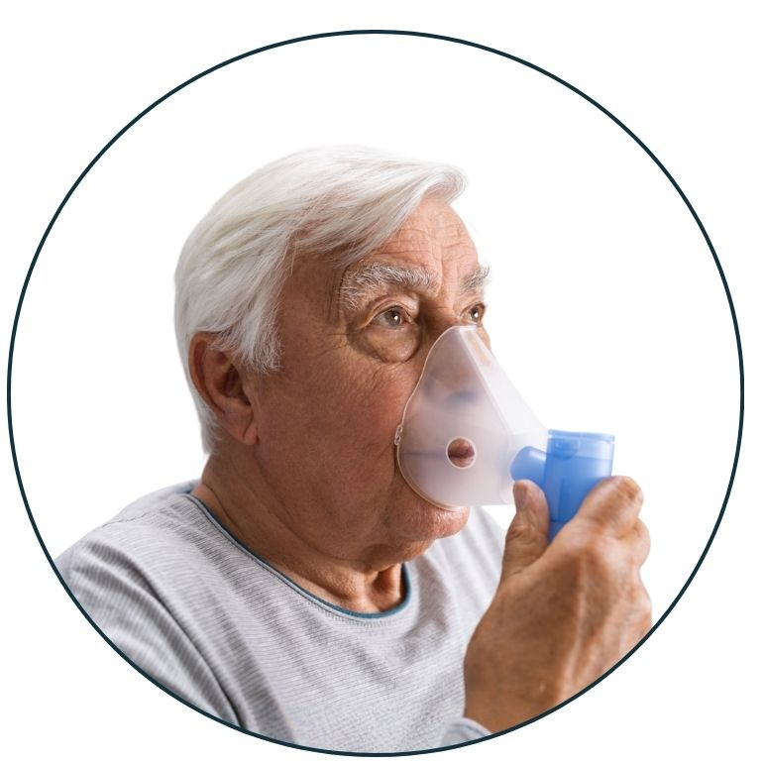
COPD: sustainable interventions to reduce harm
SOCIAL AND COMMERCIAL DETERMINANTS OF HEALTH
Prematurity
Malnutrition
Tobacco dependence
Occupational exposures
Physical inactivity
Air pollution
Lack of green space
Energy poverty
Poor quality housing
INTERVENTIONS
Low carbon inhalers: DPI & new generation propellants
Non-pharmacological interventions eg nature therapy, singing for breathing
Plant rich diets – information, cooking classes, community kitchens
Reduced fossil fuel dependence
INTERVENTIONS
Support services
Active travel infrastructure
Clean air zones
Renewable energy
Retrofitting
Quality housing
RESULT
Exacerbations
Admissions
Daily disability
HFCs from inhalers
Lack of phytonutrients
Comorbid cardiometabolic disease
IMPACTS OF CLIMATE CHANGE
Increased COPD morbidity/mortality due to heatwaves & pollution
Change in vector ecology – resp viral pandemics
Disruption to drug supply lines
MITIGATIONS
Alternative suppliers
Emergency planning
https://brit-thoracic.uk/SustainabilityToolkit
Notes:
Speakers notes: it is important to consider the causes and effects of poor health, within the wider context of social and commercial determinants of health. COPD provides a very useful example of this. In the UK the cause of COPD is largely tobacco dependence but this itself is highly associated with low socioeconomic status. Those in this group are more likely to be affected by other contributory factors such as maternal malnutrition and smoking and therefore prematurity, low wage jobs with high exposure to air pollution, poor quality housing with high exposure to poor indoor air quality, and lack of access to green space. Therefore the impacts will be worse.
Severe COPD and ongoing exposure to provoking factors leads to high use of healthcare services from inhaler use, exacerbations and admissions. This creates more climate emissions, which contributes to further COPD morbidity/mortality through heatwaves, pollution, and viral respiratory pandemics. This is a vicious circle. However there are many interventions which can act as adaptations and mitigations which would have benefits for patients and the healthcare system.

Slide 9
COPD: sustainable clinical practice
1. PREVENTION
Lifestyle medicine approach in routine care to address diet quality to reduce comorbidities
Increase referrals for treatment of tobacco dependence
MDT approach for patients with comorbidities including joint working with heart failure service
Access to specialist psychology, nutrition professionals
Promote vaccination
Optimisation of therapy for all (tailored support)
Actively address cardiovascular risk & bone health
2. PATIENT SELF-CARE
Patient support groups (incl peer support)
Online resources for breathlessness management
Use of Patient Initiated Follow Up pathways
Personalised action plan
Home NIV service – specialist physio outreach
4. LOW CARBON ALTERNATIVES
Reduce single use plastics eg in oxygen service
Reuse of salbutamol inhaler in lung function reversibility testing
Early supported discharge
Use investigations & devices with lowest carbon footprint
Use consumables with lowest carbon footprint
Low carbon inhalers (DPI, new generation propellants)
Inhaler recycling
Active travel for staff to home visits
Proactive not reactive care
3. LEAN SERVICE DELIVERY
Reduce number of visits for patients
  Reduce routine reviews – stratified follow up
  Increase telephone/virtual appointments
  Co-ordinate reviews/investigations
Reduce non-attendance
  Routinely email patients details of their appointments
  Improve pathways for patients to cancel/re-schedule appointments
  Use of Patient Initiated Follow Up
https://brit-thoracic.uk/SustainabilityToolkit
Notes:
Speakers notes: there are many opportunities to implement the four principles of sustainable healthcare in COPD care. Some are more general (eg lifestyle medicine approaches, and interventions to reduce non-attendance), whilst others are specific to COPD care (eg use of low carbon inhalers, and MDT approach for multimorbid patients especially those with respiratory failure and heart failure).

Slide 10
Sleep services: sustainable clinical practice
1. PREVENTION
Lifestyle medicine approach in routine care to address diet quality to reduce comorbidities
MDT approach for patients with obesity incl co-working with allied teams eg obesity service
Increase referrals for treatment of tobacco dependence
Home NIV service
Optimisation of therapy for all (tailored support)
Admission avoidance
2. PATIENT SELF-CARE
CPAP and NIV patient support groups (incl peer support)
Online resources for CPAP and domiciliary NIV users
Increase patient’s usage of CPAP associated mobile applications to review control of their condition
Use of Patient Initiated Follow Up pathways
3. LEAN SERVICE DELIVERY
Reduce number of visits for patients
  Reduce routine reviews – stratified follow up
  Increase telephone/virtual appointments
  Co-ordinate reviews/investigations
  Remote compliance monitoring
  Outpatient NIV setup
  Dedicated pathway for clinically challenging patients
Reduce non-attendance
  Routinely email patients details of their appointments
  Improve pathways for patients to cancel/re-schedule appointments
  Use of Patient Initiated Follow Up
4. LOW CARBON ALTERNATIVES
Reduce single use plastics/consumables
Increase provision of interface parts rather than disposal of entire mask interface (e.g mask straps)
Use investigations & devices with lowest carbon footprint
Use consumables with lowest carbon footprint
Improve retrieval of CPAP & NIV devices proven to not be in use in order to re-use
Invest and innovate in device design using circular economy principles
https://brit-thoracic.uk/SustainabilityToolkit
Notes:
Speakers notes: there are many opportunities to implement the four principles of sustainable healthcare in sleep services. Some are more general (eg lifestyle medicine approaches, and interventions to reduce non-attendance), whilst others are specific to sleep services (eg reducing waste of consumables/single use items for masks/interface).

Slide 11
ILD: sustainable clinical practice
1. PREVENTION
Lifestyle medicine approach in routine care to address diet quality to reduce comorbidities
Increase referrals for treatment of tobacco dependence
Admission avoidance
Actively address comorbidities eg allergy, reflux
Promote vaccination
2. PATIENT SELF-CARE
Patient support groups (incl peer support)
Online resources
Access to specialist nurse
Access to a telephone or email helpline
3. LEAN SERVICE DELIVERY
Reduce number of visits for patients
  Reduce routine reviews – stratified follow up
  Increase telephone/virtual appointments
  Co-ordinate reviews/investigations
  Joint Rheum-Resp clinics
Reduce non-attendance
  Routinely email patients details of their appointments
  Improve pathways for patients to cancel/re-schedule appointments
  Use of Patient Initiated Follow Up
4. LOW CARBON ALTERNATIVES
Judicious use of disease modifying drugs
Use investigations & devices with lowest carbon footprint
Reduce unnecessary testing (eg multiple CT scans)
https://brit-thoracic.uk/SustainabilityToolkit
Notes:
Speakers notes: there are many opportunities to implement the four principles of sustainable healthcare in ILD care. Some are more general (eg lifestyle medicine approaches, and interventions to reduce non-attendance), whilst others are specific to ILD care (eg reducing unnecessary testing and judicious use of disease modifying drugs).

Slide 12
TB: sustainable clinical practice
1. PREVENTION
Lifestyle medicine approach in routine care to address diet quality to reduce comorbidities
Increase referrals for treatment of tobacco dependence
Screening of high risk groups
Appropriate treatment for latent TB
Joint working with migrant support groups, homeless services/hostels
2. PATIENT SELF-CARE
Patient support groups (incl peer support)
Online resources
Multilingual resources
Access to specialist nurse
Access to a telephone or email helpline
3. LEAN SERVICE DELIVERY
Reduce number of visits for patients
  Reduce routine reviews – stratified follow up
  Increase telephone/virtual appointments
  Co-ordinate reviews/investigations
Reduce non-attendance
  Routinely email patients details of their appointments
  Improve pathways for patients to cancel/re-schedule appointments
  Use of Patient Initiated Follow Up
  Flexible appointments
4. LOW CARBON ALTERNATIVES
Use investigations & devices with lowest carbon footprint
Reduce unnecessary testing (eg multiple CT scans)
https://brit-thoracic.uk/SustainabilityToolkit
Notes:
Speakers notes: there are many opportunities to implement the four principles of sustainable healthcare in TB care. Some are more general (eg lifestyle medicine approaches, and interventions to reduce non-attendance), whilst others are specific to TB care (eg reducing unnecessary testing, screening at risk groups, and joint working with other services).

Slide 13
Bronchiectasis: sustainable clinical practice
1. PREVENTION
Lifestyle medicine approach in routine care to address diet quality to reduce comorbidities
Increase referrals for treatment of tobacco dependence
Promote vaccination
MDT approach for patients with comorbidities / complex immunodeficiency
Admission avoidance
Optimisation of therapy for all (tailored support)
Actively address cardiovascular risk and bone health
Access to respiratory physiotherapist for sputum clearance techniques
2. PATIENT SELF-CARE
Patient support groups (incl peer support)
Online resources for breathlessness management
Use of Patient Initiated Follow Up pathways
Personalised action plan
4. LOW CARBON ALTERNATIVES
Reduce single use plastics/consumables eg in nebulisers
Early supported discharge
Use investigations & devices with lowest carbon footprint
Use consumables with lowest carbon footprint
Low carbon inhalers (DPI, new generation propellants)
Inhaler recycling
Proactive not reactive care
OPAT services to avoid admissions
Antimicrobial stewardship
3. LEAN SERVICE DELIVERY
Reduce number of visits for patients
  Reduce routine reviews – stratified follow up
  Increase telephone/virtual appointments
  Co-ordinate reviews/investigations
Reduce non-attendance
  Routinely email patients details of their appointments
  Improve pathways for patients to cancel/re-schedule appointments
  Use of Patient Initiated Follow Up
https://brit-thoracic.uk/SustainabilityToolkit
Notes:
Speakers notes: there are many opportunities to implement the four principles of sustainable healthcare in Bronchiectasis care. Some are more general (eg lifestyle medicine approaches, and interventions to reduce non-attendance), whilst others are specific to Bronchiectasis care (eg OPAT services to avoid admissions, antimicrobial stewardship and access to respiratory physiotherapist for sputum clearance techniques).

Slide 14
Lung Cancer: sustainable clinical practice
1. PREVENTION
Lifestyle medicine approach in routine care to address diet quality to reduce comorbidities
Pre-hab to improve fitness pre-treatment
Increase referrals for treatment of tobacco dependence
Promote vaccination
Lung cancer screening
Tobacco control legislation
Smoke free sites
2. PATIENT SELF-CARE
Patient support groups (incl peer support)
Online resources for symptom management eg macmillan
Personalised action plan
Access to specialist nurse
Access to a telephone or email helpline
4. LOW CARBON ALTERNATIVES
Reduce single use plastics/consumables
Conservative management of iatrogenic pneumothorax post lung biopsy
Use investigations & devices with lowest carbon footprint
Use consumables with lowest carbon footprint
Active travel for staff to home visits
Proactive not reactive care
VATS/Robotic surgery leads to faster recovery and less hospital bed use
3. LEAN SERVICE DELIVERY
Reduce number of visits for patients
  Reduce routine reviews – stratified follow up
  Increase telephone/virtual appointments
  Co-ordinate reviews/investigations
Reduce non-attendance
  Routinely email patients details of their appointments
  Improve pathways for patients to cancel/re-schedule appointments
  Provide support from psychologist/health inclusion team
https://brit-thoracic.uk/SustainabilityToolkit
Notes:
Speakers notes: there are many opportunities to implement the four principles of sustainable healthcare in lung cancer care. Some are more general (eg lifestyle medicine approaches, and interventions to reduce non-attendance), whilst others are specific to cancer care (eg minimally invasive surgery to reduce hospital bed use, lung cancer screening and use of pre-hab).

Slide 15
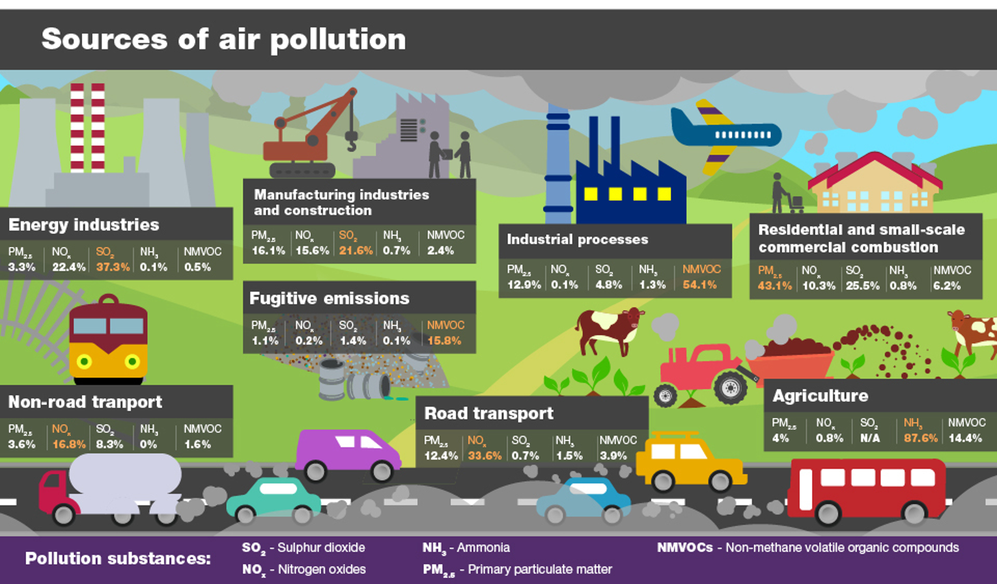
Outdoor air pollution
https://brit-thoracic.uk/SustainabilityToolkit
Image credit: Public Health England Health matters: air pollution - GOV.UK
Notes:
Speakers notes: This graphic from the Chief Medical Officer’s report on air pollution shows the major pollutants and their sources. The 2 pollutants with the greatest health effects are PM2.5 (particulate matter) and NOx (nitrogen oxides) but others such as VOC (volatile organic compounds), NH3 (ammonia) and SO2 (sulphur dioxide) are significant especially when they peak. Most people think about emissions from transport, energy and industry, but perhaps are not aware of the significant contribution from animal agriculture and from residential burning eg wood burning stoves.

Slide 16
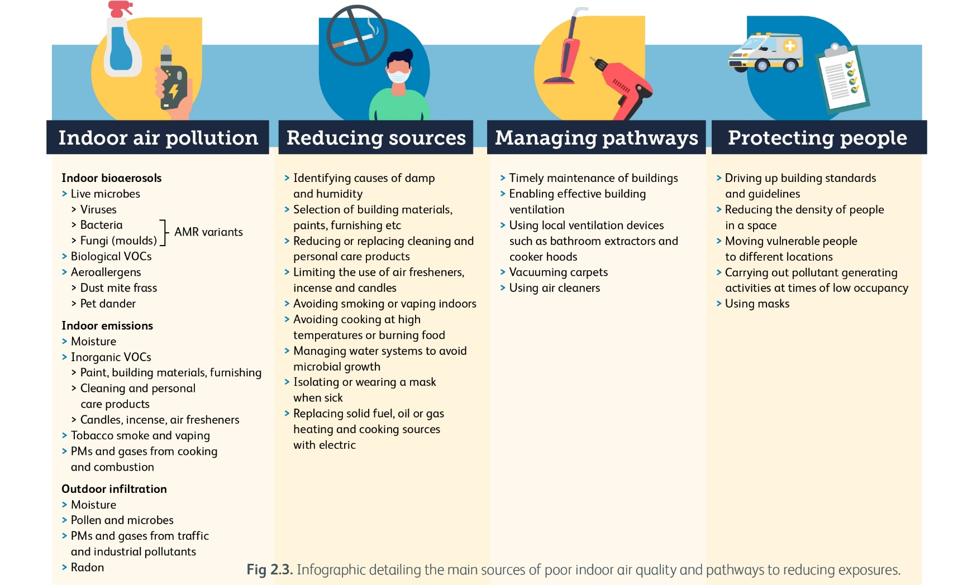
Indoor air pollution
https://brit-thoracic.uk/SustainabilityToolkit
Image used with permission from Royal College of Physicians report A breath of fresh air: responding to the health challenges of modern air pollution
Notes:
Speakers notes: this image from the Royal College of Physicians report on air pollution highlights sources of poor air quality and some important and effective ways to reduce exposures.

Slide 17

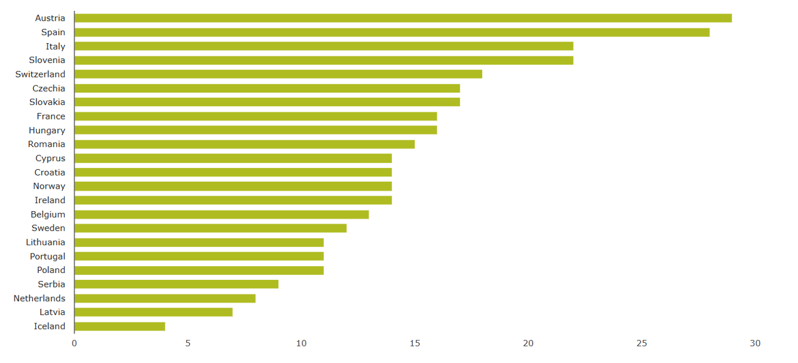
Air pollution: ozone
Hospital admissions for respiratory disease by 100,000 inhabitants attributable to O₃ for adults aged 65 years and above
High temperatures can increase exposure to ground-level ozone, both of which can exacerbate respiratory diseases.
https://brit-thoracic.uk/SustainabilityToolkit
Image credit: European Environment Agency Hospital Admissions for Respiratory Disease
Notes:
Speakers notes: there is a wealth of data on the health impacts of air pollution. This chart from the European Environment Agency shows hospital admissions for respiratory disease attributable to ground level ozone, and shows that the numbers are really significant.

Slide 18
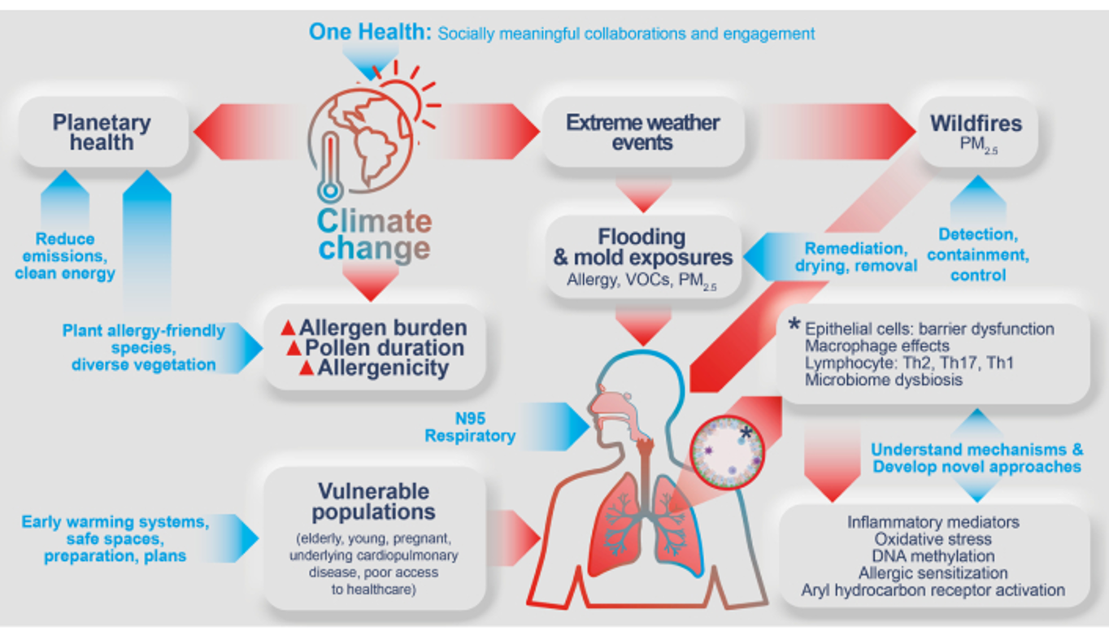
Allergens and climate change
Overview of the negative consequences (red arrows) attributed to climate change with approaches and interventions to mitigate the adverse allergy and immunology health consequences (blue arrows).
VOC: volatile organic compounds; PM2.5: particulate matter with a diameter of less than 2.5 μm.
https://brit-thoracic.uk/SustainabilityToolkit
Image credit: Vitry L. Climate change and allergy: a call for action in Europe. Explore Asthma Allergy. 2025;3:100987.
Notes:
Speakers notes: Climate change often has intersecting impacts, which multiply these impacts. Climate change increases allergenicity of plants and pollen duration. Climate change also increases the frequency and severity of wildfires which releases particulate matter. These interact as higher air pollution also increases pollen delivery to the airways. So both will interact and worsen allergies. There are many other factors such as flooding an mould exposure, and microbiome changes. The blue arrows on this diagram highlight actions that we can take to mitigate these consequences which range from indicivual actions such as wearing a N95 mask, to broader actions such as transitioning to clean energy and containment of wildfires.

Slide 19

Is your subspeciality missing from this slide set?
Do you have an idea for how to make your area of interest sustainable?
Get in touch at contact@RespiratoryFutures.org.uk
https://brit-thoracic.uk/SustainabilityToolkit
Notes:
Please share your ideas! Thank you.

